Slide 1
Overview of Embedded Systems
Dept. of Electronics and Communication Engineering
Galgotias University

Slide 2
UNIT 1
UNIT I INTRODUCTION TO EMBEDDED SYSTEM
Basic components of Embedded system, Programming Language, Classification of Embedded system, Advantage & Disadvantage, Difference between Microprocessor & Microcontroller, Classification based on architecture, Memory Classification, Description of RAM, Description of CPU Registers, Introduction to Embedded C, Difference between C & Embedded C.

Slide 3
BOOKS
Text Books:
[T1] Design with PIC Microcontrollers, John B. Peatman, Pearson Education Asia, 2002
[T2] ARM System Developer’s Guide: Designing and Optimizing System Software, Andrew N. Sloss, Dominic Symes, Chris Wright, Morgan Kaufman Publication, 2004.
[T3] Computers as components: Principles of Embedded Computing System Design, Wayne Wolf, Morgan Kaufman Publication, 2000
Reference Books:
[R1] The Design of Small-Scale embedded systems, Tim Wilmshurst, Palgrave2003
[R2] Embedded System Design , Marwedel ,Peter , Kluwer Publishers , 2004.

Slide 4
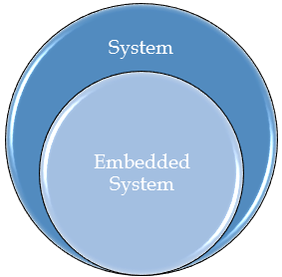
WHAT IS SYSTEM ???
A system is a group of units that are joined together to work in a specific routine and perform some fixed operation.
These units could be of any nature i.e. if you are working on an electronics system then these units will be electronic components.
Similarly, if you are working on some mechanical system then these units will be mechanical equipment or machinery etc.

Slide 5
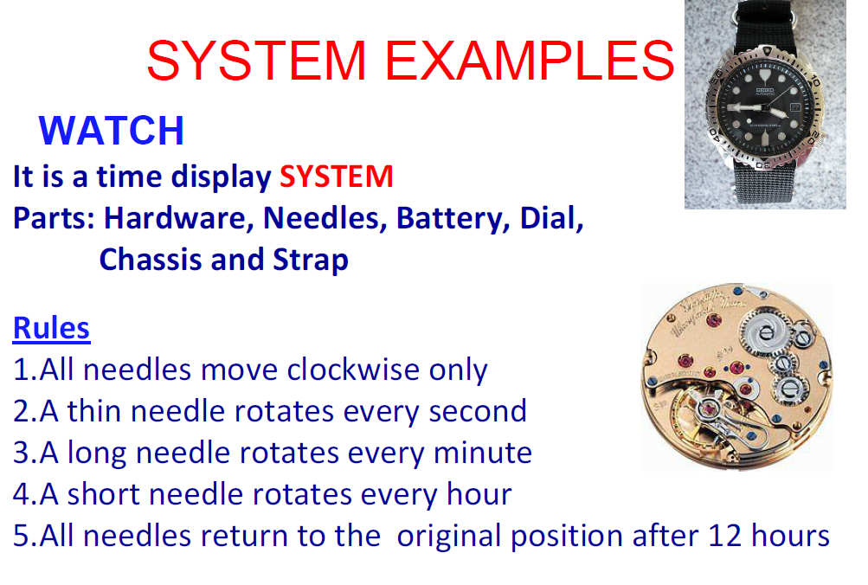

Slide 6
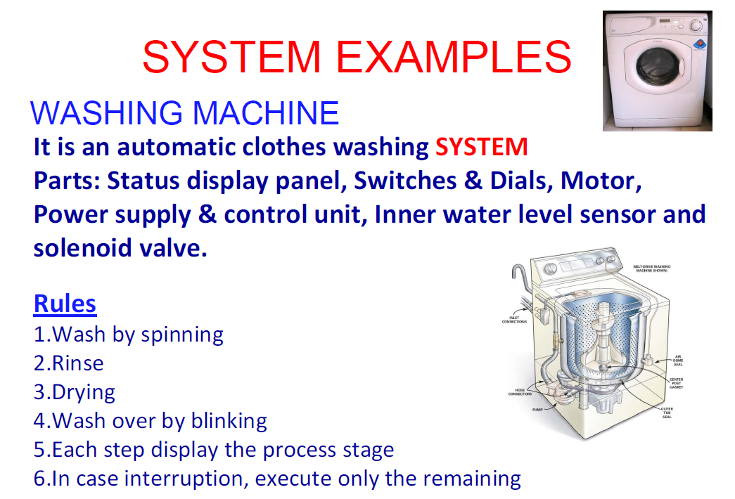

Slide 7
WHAT IS EMBEDDED SYSTEMS ???
Embedded System - As its name suggests, Embedded means something that is attached to another thing. Embedded System is a computer system embedded into an device, appliance or a unit that is used to create any automation device or to control any machines using Micro Controller.
Any sort of device which includes a programmable computer but itself is not intended to be a general-purpose computer”
It includes hardware as well as software and it is a part of a larger system and is expected to function without human intervention.
An embedded system is expected to respond, monitor as well as control external environment using sensors and actuators.
So, basically what we are talking about is embedding a computer into an appliance and, that computer is not expected to be used for general purpose computing. Since it is embedded into an appliance, it needs to interact with the external world, so it has got analog interfaces.

Slide 8
Embedded Systems
An embedded system is that system which has computer hardware with software embedded in it. Microcontrollers normally used to design embedded systems are Arduino, PIC Microcontroller, Atmel Microcontroller, 8051 Microcontroller etc.
A general purpose computer such as Pentium PC is not an embedded system as it does not perform only specific functions. It can be used for a number of applications. Different programs can be installed on a PC for different tasks. A PC has a RAM and an operating system. The operating system loads application software into RAM and then the CPU runs it. While in the case of an embedded system, there is ROM in which application software is burned which can usually perform only one task.
A PC itself is connected to many embedded systems, such as printer, keyboard, mouse, scanner, modem and many others. Such systems perform specific functions and have their own microcontrollers in them. I am going to explain this with some examples.

Slide 9
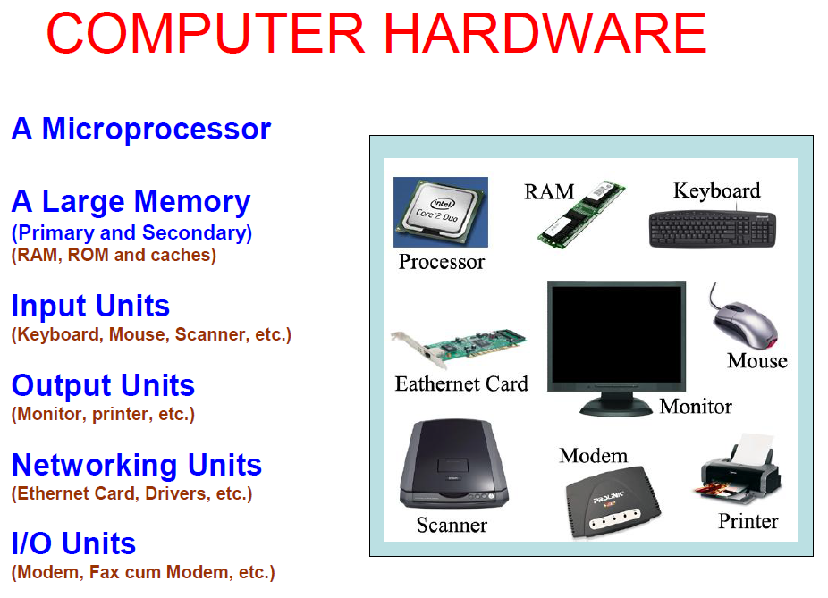

Slide 10
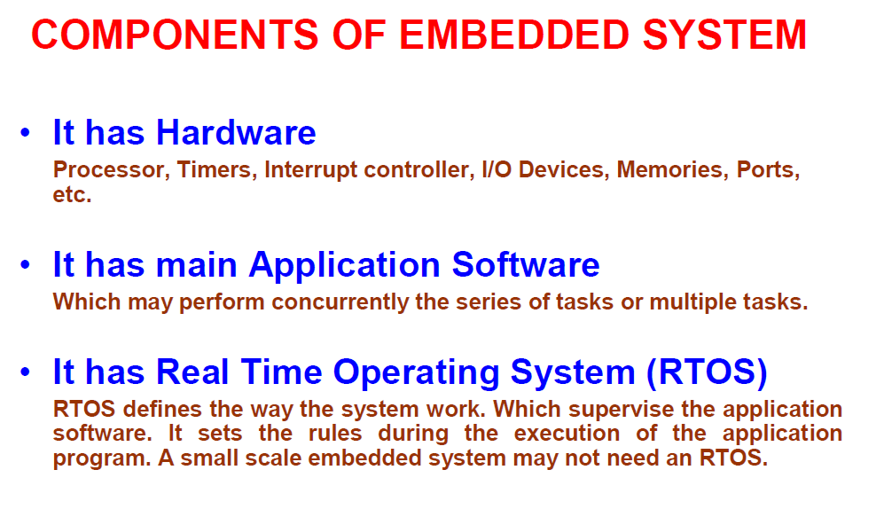

Slide 11
EXAMPLES OF EMBEDDED SYSTEM
There’s an endless list of Examples of Embedded Systems. Some of the most exciting Examples of Embedded Systems
Digital Camera
Automotive Embedded Systems
Home Security Systems
Automatic Washing Machine
Personal Digital Assistant
Industrial Robot
Automated Teller machine (ATM)
Calculator
Printer

Slide 12
Digital Camera
A digital camera is very good example of embedded systems.
Cameras that we use today are smart and have a lot of features that were not present in early cameras all because of embedded system used in them.
A digital camera has basically three functions, to capture image which we call data, to store image data, and to represent this data.
Today images are stored and processed in form of digital data in bits.
There is no need of film for storing images. This feature has increased the storage capacity and made it easy to transfer images.
In digital cameras, first image is captured and converted to digital form.
This digital image is stored in internal memory.
When the camera is attached to your personal computer for uploading images, it transfers the stored data.
If I talk about smart camera, it has some extra features than digital cameras.

Slide 13
Digital Camera
Smart cameras are able to capture details of the scene.
These cameras analyze the images and are able to detect humans, motion, faces etc. from the whole image.
For detection of objects in the image, some processing is required in cameras.
Usually, image processing includes low level processing and high level processing.
Various algorithms are available that are employed for this purpose.
Components of a smart camera include,
image sensor that may be a CCD (Charge Coupled Device) or a CMOS (Complementary metal oxide semiconductor)
Analog to digital converter (A2D)
Image Processor
Memory
Lens
Led or other illuminating device
Communication Interface etc.
Smart cameras may consist of some more devices depending on features.
So, we can say that camera is one of the important embedded systems examples. It has its own processor, sensors, actuators and also memory for storage purposes

Slide 14
Automotive Embedded Systems
Examples of embedded systems include automotive. Today cars use embedded systems replacing old traditional systems.
Electronic Control Units are used in automotive embedded systems Examples.
This unit contains microcontroller, switches, sensors, drivers, etc.
All the sensors and actuators are connected to electronic control unit.
Automobiles using embedded systems may consists of hundreds of microprocessors.
Each microcontroller performs its own dedicated task. Some of them control engine. Some run dashboard devices.
The whole system is actually comprised of several small systems.
Using embedded systems in automotive has reduced the cost factor.
It has improved the overall performance and increased functionality.
It has also reduced weight and made automobile more safe and reliable.
Applications of automotive embedded systems include:
Automatic Stability Control
Traction Control System
Pre-crash Safety System
Air bag
Car Navigation System
So you can see that using embedded systems in automobiles is very useful and has increased the functionality of automotive.

Slide 15
Home Security System
In embedded systems examples, I have another interesting one on my list that is home security system.
Home security systems are used largely today.
These systems have several features just as checking for fire or gas leakages, and detecting if someone suspicious tries to enter the house.
A microcontroller is used for controlling all the operations. Sensors give data and if something wrong happens than safety alarms get activated.
Sensors used in such systems include gas sensors, smoke sensors, temperature sensors, IR sensors etc.
Also a keypad is included in such systems for entering password at the gate.
If correct password is entered then this embedded system opens the gate and if someone tries to enter wrong password than alarm is set on and gates remain closed.
The output is received from alarms or some display.
The output can also be sent to some distant location.
If family members are not present in home then still they can monitor the activities going on in their house.
Home security system is not limited to homes.
Such systems can be used at shops, stores and in industries.
Almost every industry and office has security systems that can recognize the workers from their face or identity cards.
Home automation system is also one of the examples of embedded systems as home security system.

Slide 16
Automatic Washing Machine
Daily life examples of embedded systems include automatic washing machines and dryers.
Washing clothes is not a difficult task now owing to embedded systems.
You just have to add clothes and leave it to the machine. Rest operations are done by your machine itself.
Machines have a microcontroller for controlling all the tasks.
Sensors and actuators in this case are level sensors, valves, motor and also a display and keypad to input information.
Once you load clothes in machine, the whole process consists of three cycles. Washing, rinsing and spinning. All the three cycles are initiated by machine itself. You just have to enter information for hot or cold water and press start button.
During washing and rinsing cycle, water is added to the drum by pipes.
Closing and opening of valves for adding water is checked through level sensors by microcontroller.
Then the rotation of drum starts for pre-set time. After that water is drained out through pipes.
During spinning cycle, water is not added and drum rotates for a set time.
All the processes are controlled by microcontroller program.
The timings for each cycle can be changed through the keypad.

Slide 17
Personal Digital Assistant
Personal digital assistant (PDA) is the next example on my list. It’s a device for personal use.
You can find a lot of personal embedded systems examples like Mobile Phones, data organizers, PDA etc.
Personal Digital Assistant is just like a personal computer in hand. It was used before smart phones came out.
PDA is used as information manager and has the ability to connect to internet.
It has a display mostly touch screen for the user to interact with the device.
The display is used for entering data, memory card is used for storing data and it is provided with Bluetooth or WiFi for connectivity.
Some of the personal digital assistants use keypads instead of touch screen to input information.
This device is very handy in managing and sorting personal information. It is very light in weight and serves multiple functions.

Slide 18
Industrial Robots
Embedded systems have a lot of applications in industries.
Today, every process is being taken towards automation. So industrial robots are very important to mention with embedded systems examples.
An industrial robot is an embedded system that comes in a variety of forms and each performs a number of different tasks. Some industrial robots are used for moving parts, tools, materials etc.
Some are used in assembly operations while some of them are used in manufacturing.
These robots have increased the productivity.
They are widely used where precise operations are required or at the places which are difficult to access for humans.
To understand the working of industrial robot as example of embedded systems, I am going to tell you about automated painting robots.
Painting robots have a wide application area.
They are replacing humans as they require less time for the whole operation and ensure best result.
All of the activities are controlled through the program.
Timing for the whole process and amount of paint is preset.
Assembly robot is another example of industrial robots.
The task of such robot is to create an assembly from all the parts.
All parts are collected and assembled in correct sequence to form final product.
There are a lot of examples of industrial robots.
All are good embedded systems examples.

Slide 19
Automated Teller Machine
An automated teller machine (ATM) is also an embedded system.
It is a computerized device used in banking.
You all are already familiar with its operation and use.
A customer can access and perform his transactions without going to the bank and meeting some assistant.
This machine consists of a card reader for detecting card and accessing information of the person.
Also it has a keypad so the user can enter his commands and password.
A screen displays information. A printer prints the receipts and cash is received from cash dispenser.
A network is present between the bank computer and ATM machine through a host computer.
All the data is verified with the bank computer and all transactions are stored in it.
All these input and output operations are carried with the help of microcontroller.
So this makes a one of the best examples of embedded systems.

Slide 20
Calculator
Calculator is also one of the examples of embedded systems.
Actually it is one of very earlier embedded system that is used widely.
In this example, the function is to take input from the keypad, perform the required operation and show the results on LCD.
Embedded Scientific Calculator has a high performance processor.
A number of mathematical complex calculations can be performed by these calculators.
You can also program such scientific calculators.
With such kind of functionality, these calculators are very advance as compared to simple calculators, all because of embedded systems.

Slide 21
Printer
A printer is an example of an embedded system.
It does not need an external controller.
It has its own control unit embedded in it
The controller is programmed to perform only one function that is specific.
The function performed by the printer is to read the data and print it on the paper.

Slide 22
FEATURES OR CHARACTERISTICS:
Single-functioned /Task Specific
As I told in the previous section that an embedded system is not general purpose
It is designed to perform special functions. For e.g. A pager always functions as a pager.
So, embedded systems are designed for doing some specific tasks and then they are installed and those embedded systems keep on doing their specific tasks.
Sophisticated functionality
An embedded system possesses sophisticated functionality. The degree of sophistication can vary from appliance to appliance.
Embedded system being used in Microwave oven has simple functions so 16 bit microcontroller can be used in that while in automotive applications complex embedded system having 32 bit microcontrollers are used.

Slide 23
FEATURES OR CHARACTERISTICS:
Real Time Operation
Another feature of these systems is that they work in real time.
The basic definition is that operations must be completed by deadlines. So if I have a deadline, a real time operation must be completed within deadline.
We have two kinds of real time deadlines- hard real time deadlines and soft real time headlines and accordingly also, we classify real time systems.
In a hard real time systems, we cannot really miss a deadline. If you are talking about an atomic reactor control, if I miss a deadline then there can be a catastrophe.
On the other hand, for a soft real time systems, we can at times miss deadline. See for example, when we are playing a video on a laptop even if we cannot decode a frame in time, nothing catastrophic happens, only it disturbs you viewing experience.

Slide 24
FEATURES OR CHARACTERISTICS
Tightly constrained
All computing systems have constraints on design metrics, but those on an embedded system can be especially tight. Design metrics is a measure of an implementation's features such as its cost, size, power, and performance. It must be of a size to fit on a single chip, must perform fast enough to process data in real time and consume minimum power to extend battery life.
Performance
The overall performance and accuracy of an embedded system also counts.
It is measured considering all the conditions and constraints on the system.
So, if your embedded system is just measuring the atmospheric temperature then it will be quite efficient because its quite an easy task.
Cost
The cost factor is another important feature.
Such systems are built for performing specific functions, and in large quantities.
The design process is costly but once a system is designed, customized and produced in bulk, overall cost becomes minimum.
Size
One of the feature of an embedded system is its size.
The size should be small and it is done by adding more functionality in a single chip so that the need for external parts is reduced.

Slide 25
FEATURES OR CHARACTERISTICS
Power Consumption
The power consumption is also low.
This feature is becoming more and more important in new systems.
Sometimes it happen that your embedded system has to be isolated and need to run for a very long time so in such cases the power consumption is a critical factor and it has to be really low.
Reactive and Reliability
Embedded systems are reliable if they are operated under normal conditions. Embedded systems should be highly reliable and stable. Unlike usual computers, embedded systems use different underlying software that cannot be modified by consumers. Since they will be used for long periods of time and cannot be programmed easily, they’re expected to run without any problems. In the case of some applications like undersea communication cables, navigation beacons or automobile components, maintenance is extremely difficult, if not highly improbable, so reliability is paramount.
Embedded systems are usually feedback oriented or reactive. They function either by interacting with external stimuli, or depend on another system to give them an input.

Slide 26
FEATURES OR CHARACTERISTICS
Microprocessors based
It must be microprocessor or microcontroller based.
Memory
It must have a memory, as its software usually embeds in ROM. It does not need any secondary memories in the computer.
Connected
It must have connected peripherals to connect input and output devices.
HW-SW systems
Software is used for more features and flexibility. Hardware is used for performance and security.

Slide 27
CONSTRAINTS FOR AN EMBEDDED SYSTEM
The constraints on designing of almost every embedded system:
Available System Memory
Available processor speed
Power Dissipation
Size
Cost

Slide 28
Components of embedded systems
The components used to build up an embedded system can be categorized into four classes.
Analog Components
Digital Components
Converters
RTOS and Software
Analog Components
Analog Components are very necessary components of such a system. They are important because they help in interacting with real world. Examples of analog components are:
Sensors.
Actuators.
Controllers.

Slide 29
Components of embedded systems
Digital Components
Digital components mostly reside on the chip and do the processing operations. Examples are:
Processors.
Co-processors.
Memory.
Controllers.
Buses.
Application Specific Integrated Circuits (ASIC).
Converters
Converters are very important building blocks. They are useful so that digital and analog components can work together. For example:
Analog to Digital Converter (A2D).
Digital to Analog Converter (D2A).

Slide 30
Components of embedded systems
Software
Without software an embedded system cannot work. The software is written in high level language. This software is burnt to some non volatile memory. Examples are:
Application Programs.
Exception Handlers.
RTOS
Real Time Operating system (RTOS) supervises the application software and provide mechanism to let the processor run a process as per scheduling by following a plan to control the latencies. RTOS defines the way the system works. It sets the rules during the execution of application program. A small scale embedded system may not have RTOS.
So these were the components of an embedded system. Let’s now talk about its basic structure

Slide 31
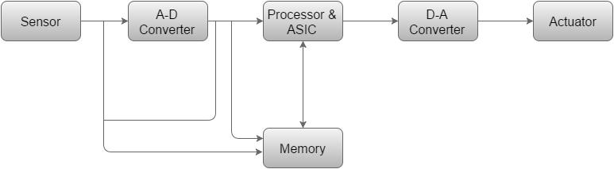
Structure of an Embedded System
The following illustration shows the basic structure of an embedded system −

Slide 32
Structure of an Embedded System
Sensor − It measures the physical quantity and converts it to an electrical signal which can be read by an observer or by any electronic instrument like an A2D converter. A sensor stores the measured quantity to the memory.
A-D Converter − An analog-to-digital converter converts the analog signal sent by the sensor into a digital signal.
Processor & ASICs − Processors process the data to measure the output and store it to the memory.
D-A Converter − A digital-to-analog converter converts the digital data fed by the processor to analog data
Actuator − An actuator compares the output given by the D-A Converter to the actual (expected) output stored in it and stores the approved output.

Slide 33
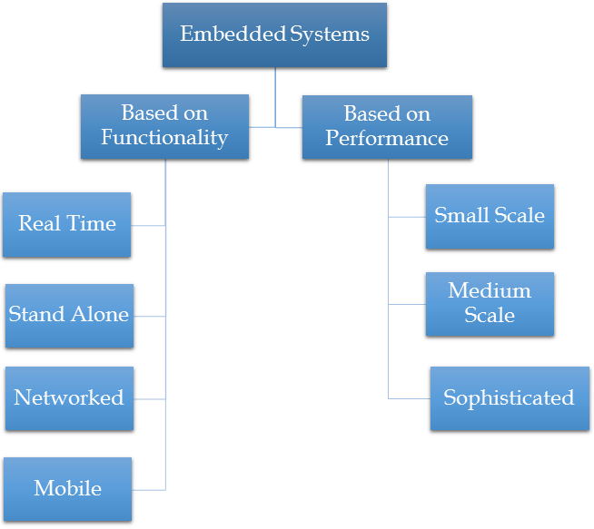
Classification of Embedded Systems

Slide 34
Functionality Based Embedded Systems
Based on functions performed by embedded systems, it is divided into four types:
Real Time
An embedded system that gives an output within a specified amount of time is called a real-time embedded system. That is, in addition to a proper output, it adheres to time constraints as well. They can be further classified into soft real-time embedded systems and hard real-time embedded systems.
Stand Alone
As the name suggests, these are embedded systems that can work by themselves. In other words, they are self sufficient, and don’t require a host system or computer to function. While they will require inputs and other devices for output, the processing and work is done only by themselves. Examples include videogame consoles, music players and microwave ovens.

Slide 35
Functionality Based Embedded Systems
Networked Embedded Systems
Embedded systems that are connected to a network and depend on it for their functioning are called networked embedded systems. They may or may not have smaller or less complex subsystems running to create the network. Examples include home security systems and heat sensor systems.
These systems are connected with network that could be LAN, WAN or internet. The connection can be wireless or wired.
Mobile Embedded Systems
Embedded systems meant for mobile communications are called mobile embedded systems. They include mobile phones, tablet computers and the like, and are usually categorized by functions like internet, calling, in addition to more complex functions seen in today’s smartphones. This is the class of embedded systems which is used in portable devices.
The examples of devices are mobile phones, cameras, music players etc.

Slide 36
Performance based Embedded systems
Based on performance of microcontroller, they are divided into three types:
Small Scale Embedded Systems
If the microcontroller used in embedded system is 8 bit or 16 bit then it is classified into small scale embedded system.
Such systems have less complex hardware and software parts and can also be operated on batteries.
Normally such embedded system uses Arduino boards or PIC Microcontrollers or 8051 Microcontrollers etc.

Slide 37
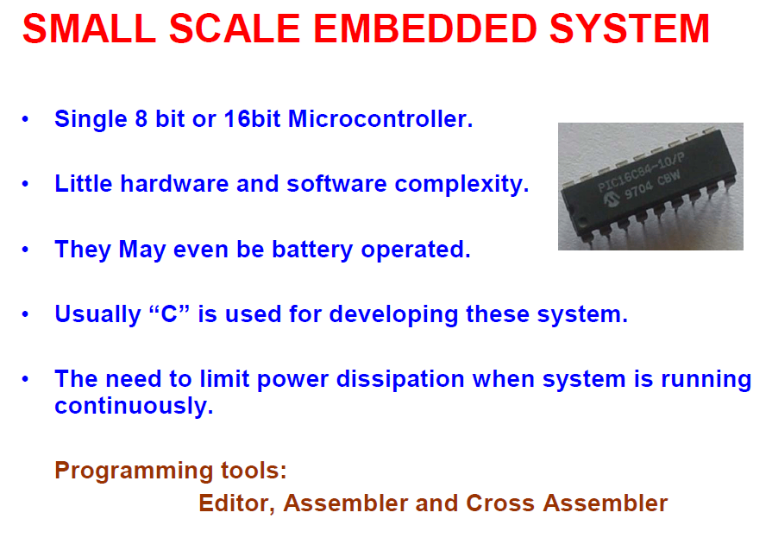

Slide 38
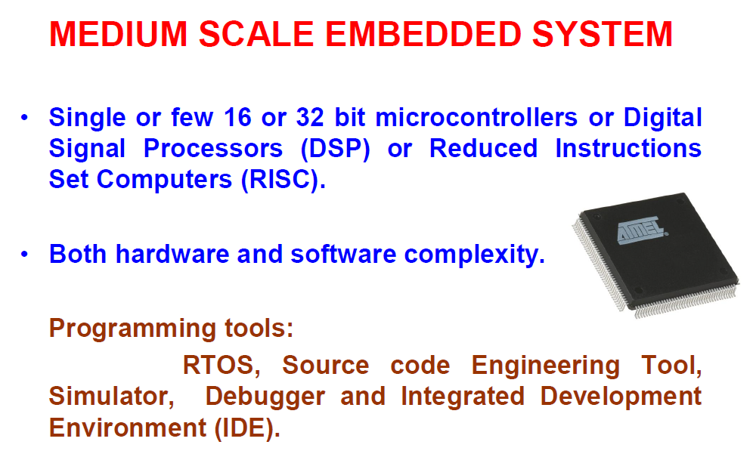

Slide 39
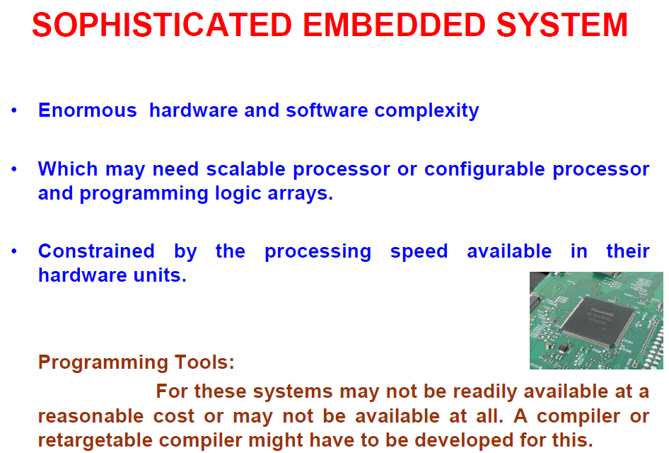

Slide 40
Performance based Embedded systems
Medium Scale Embedded Systems
The second class is medium scale embedded system.
It uses one or more than one 16 bit or 32 bit microcontrollers.
It may use DSP (digital signal processor) or may use RISC (reduced instruction set computer).
Hardware and software of these systems are complex.
Sophisticated Embedded Systems
The third class of embedded systems is sophisticated.
Such systems have huge hardware and software complexity.
So they need PLA (programmable logic array), scalable or configurable processors.
These systems have speed constraints.

Slide 41
Advantages of Embedded systems
The embedded system is easy for mass production.
The embedded system is highly reliable.
It has very few interconnections.
The embedded system is small in size.
The embedded system has less expensive.
It has fast operation.
It has improved product quality.
It optimizes use of system resources.
It has low power operation.

Slide 42
Disadvantages of Embedded systems
The embedded systems are hard for maintenance as it is use and throw device.
Less power supply durability if it is battery operated.
It has hard to take backup of embedded files.

Slide 43
Difference between Microprocessor and Microcontroller
Microprocessor is a general purpose device
General-purpose microprocessors contains
No RAM, No ROM, No I/O ports
Microcontroller
A microcontroller is a single-chip VLSI unit (also called microcomputer) which, although having limited computational capabilities, possesses enhanced input/output capability and a number of on-chip functional units.
Microcontroller has CPU (microprocessor), RAM, ROM, I/O ports, Timer
ADC and other peripherals
Microcontrollers are particularly used in embedded systems for real-time control applications with on-chip program memory and devices.

Slide 44
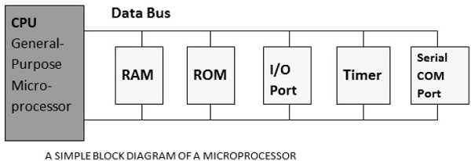
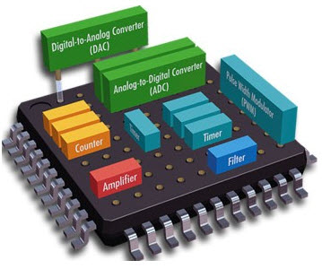
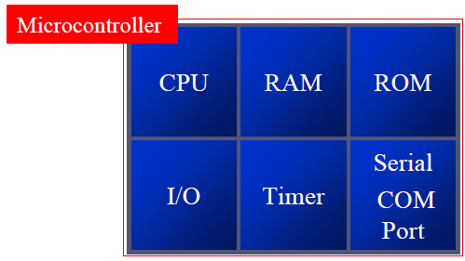
Difference between Microprocessor and Microcontroller

Slide 45
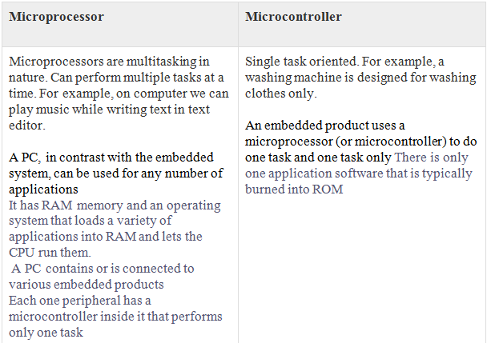

Slide 46
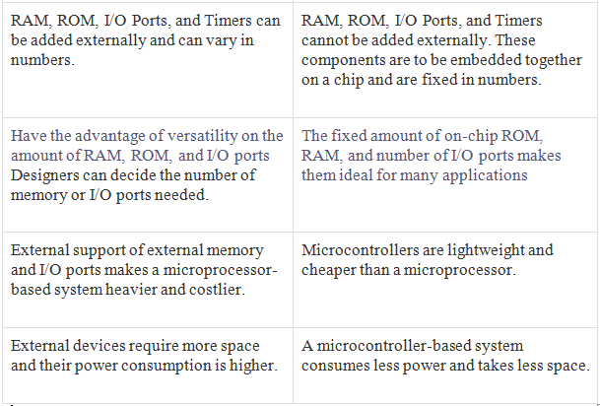
Microprocessor Microcontroller

Slide 47
Classification of Microcontroller
Internal bus width:
4 bit
8 bit
16 bit
32 bit
Instruction set:
C.I.S.C – complex instruction set computers
R.I.S.C – reduced instruction set computers
Architecture:
Harvard
Von Neumann (or Princeton)
Memory:
Embedded memory
External memomy
Families:
ATMEL AVR - atmega, Xmega, Attinyâ€¦
PIC - PIC16F, PIC18F
ARM - ARM7, ARM9, ARM11
8051 - AT89s52, p89v51rd2
Motorola - 68HC11

Slide 48
Classification According to Architectures
Harvard architecture
When data and code lie in different memory blocks, then the architecture is referred as Harvard architecture.
The Harvard architecture offers separate storage and signal buses for instructions and data. This architecture has data storage entirely contained within the CPU, and there is no access to the instruction storage as data. Computers have separate memory areas for program instructions and data using internal data buses, allowing simultaneous access to both instructions and data.
Von Neumann architecture
In case data and code lie in the same memory block, then the architecture is referred as Von Neumann architecture. In this architecture, one data path or bus exists for both instruction and data. As a result, the CPU does one operation at a time. It either fetches an instruction from memory, or performs read/write operation on data. So an instruction fetch and a data operation cannot occur simultaneously, sharing a common bus.

Slide 49
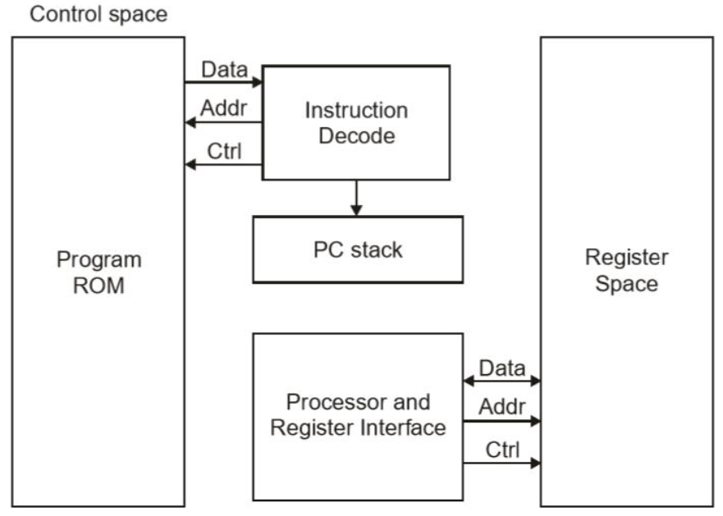
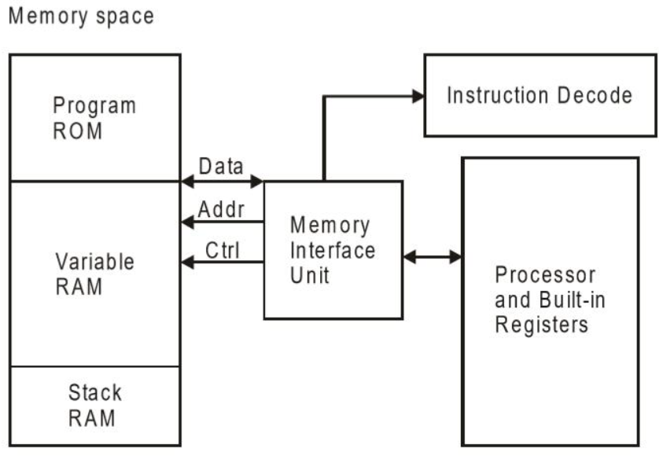
Classification According to Architectures
Harvard
Von Neumann

Slide 50
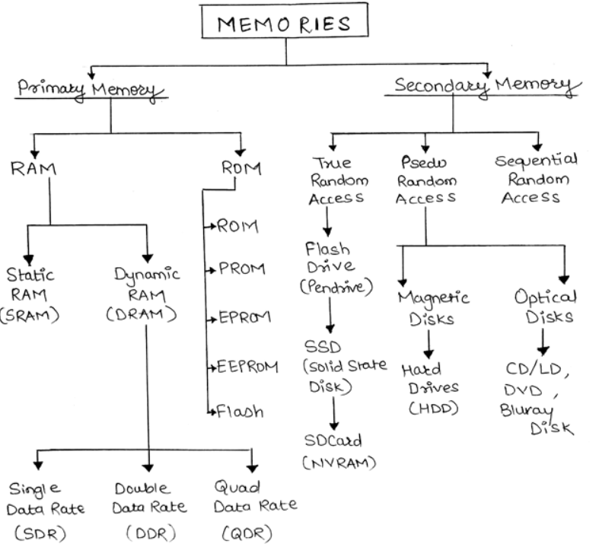
Classification of Memory

Slide 51
Memory classification
Memory can be broadly classified into 2 types namely
Primary memory &
Secondary memory.
The real difference between primary and secondary memories is the speed/volatility tradeoffs.

Slide 52
Primary memory
Primary memory is directly addressed by the processor.
Types
RAM
ROM

Slide 53
RAM: (Random Access Memory)
RAM: (Random Access Memory) Read or write memory. It stores temporary data and stack.
Two most important types of RAM are
SRAM
DRAM.
They are both volatile memories used as primary storage on embedded systems. But each has its place in microcontroller design. The main difference between them comes from their speed/cost tradeoffs.

Slide 54
Types of RAM
1. Static Random Access Memory (SRAM)
Data is stored in the form of voltage. It is made up of flip flops. It is realized using 6 transistors. 4 transistors are part of flip flop and two transistors are for control access.
This is the faster of the two, approximately 4 times faster than the DRAM.
Since it needs more transistors per bit of data, it is also more expensive compared to DRAMs.
2. Dynamic Random Access Memory (DRAM)
It stores data in the form of charge. It is made up of MOS transistors. The circuit has 1 MOSFET and a capacitor.
The reason behind its name comes from the fact that the data stored in this RAM needs to be refreshed every few milliseconds or else it will end up being erased. Yes even if the power is being applied continuously the data still needs to be refreshed. This action is taken care of by a special device named DRAM controllers.
The reason behind this dynamic behavior is because of the capacitor present in its design.
Earlier the SRAM was called just RAMs but later after the introduction of DRAMs, the term “static” got introduced into its name in order to differentiate it from the DRAM technology!

Slide 55
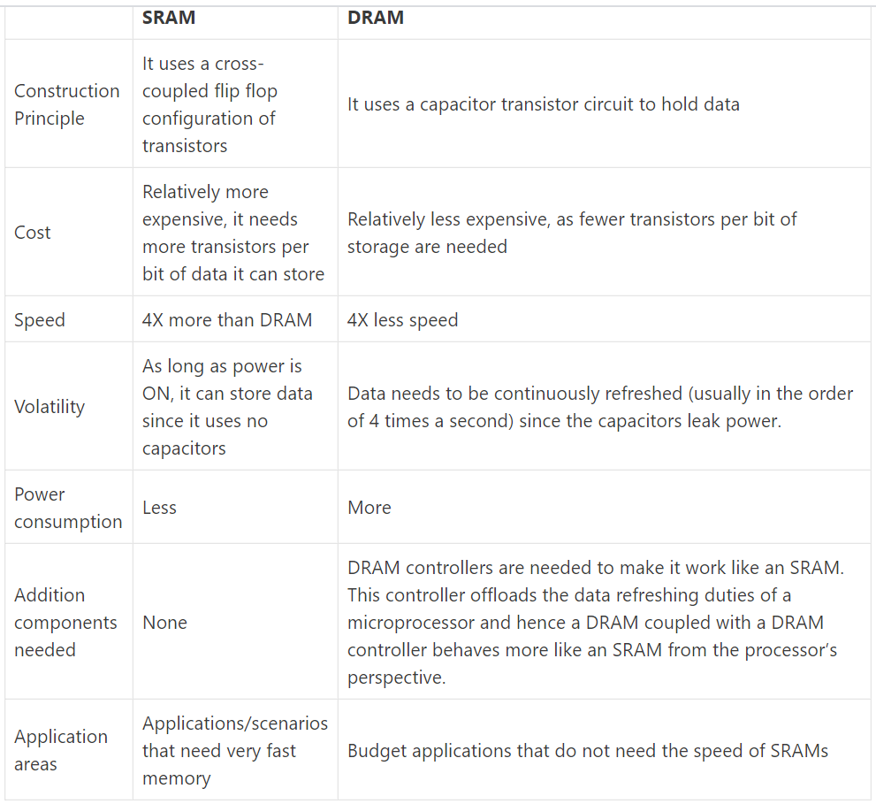

Slide 56
ROM: (Read Only Memory)
It stores application programs from where processor fetches instruction code. It stores codes for system booting and RTOS.
It retains content even after system is turned off. It is a non-volatile storage memory.

Slide 57
Types of ROM
1. MROM - Mask Read Only Memory
MROM is the short form of Mask Read Only Memory. It is inexpensive and is the very first ROM which is hard wired device that contains a pre-programmed set of data or instructions.
2. PROM - Programmable Read Only Memory
PROM is read-only memory chip that data can be written only once by a user. The difference between it and the read only memory is that PROM is manufactured as a blank memory, while the ROM is programmed during the manufacturing process.
The user buys a PROM, the user will need a special device called a PROM programmer or PROM burner to write the desired data onto the blank PROM chip. The process of programming a PROM is sometimes called burning the PROM. The memory can be programmed just once after manufacturing by "blowing" the fuses, which is an irreversible process.

Slide 58
Types of ROM
EPROM - Erasable Programmable Read Only Memory
EPROM is a special kind of read only memory chip that has the opportunity to erase the programmed data, which the feature can be seen from its name.
The programmable read-only memory can be programmed to write data with high voltage, and the data remains until it is exposed to ultraviolet light for lasting up to 10 minutes or longer.
Usually, an EPROM eraser can achieve this purpose, making it possible to reprogram the memory. For this purpose, a quartz transparent window is reserved on the package of the memory for easy exposure.

Slide 59
Types of ROM
EEPROM - Electrically Erasable and Programmable Read Only Memory
EEPROM is also a kind of read only memory that the principle of operation is similar to EPROM which we have mentioned, but the ways to program and erase are done by exposing it to an electrical charge, so no transparent window is needed.
It can be erased and reprogrammed about 10,000 times. Both erasing and programming take about 4 to 10 milliseconds. In the EEPROM, users can selectively erase and program any location and it can be erased one byte at a time instead of being erased the entire chip. Therefore, the process of reprogramming can be flexible but slow.
Flash Memory
Flash memory (flash) is a modern type of EEPROM. Flash memory can be erased and rewritten faster than ordinary EEPROM, and newer designs has the feature that is very high endurance (exceeding 1,000,000 cycles).

Slide 60
Secondary Memory
Secondary Memory
Secondary memory is not directly addressed by the processor.
Programs and data are kept on a long term basis. It has enormous storage capacity as compared to primary memory.
Secondary memory does not care if the power is present or not, it can happily hold its contents. But compared to Primary memory, they are relatively slow. Popular implementations include the Hard disks, SSDs, USB Flash drives, and SD cards.

Slide 61
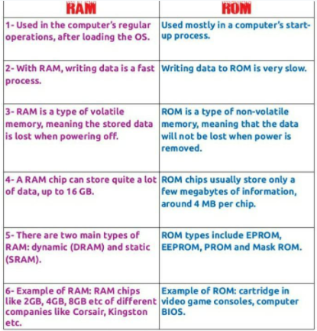
Difference between RAM and ROM

Slide 62
CPU
CPU-central processing units
brain of a microcontroller
responsible for fetching the instruction, decodes it, then finally executed.
connects every part of a microcontroller into a single system. The primary function of CPU is fetching and decoding instructions. Instruction fetched from program memory must be decoded by the CPU.

Slide 63
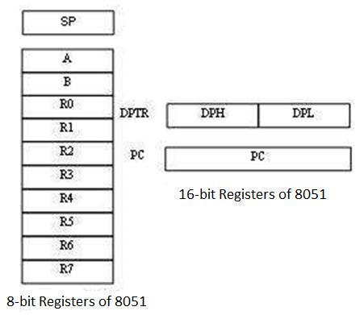
Registers of 8051
Storage Registers in 8051
Accumulator
R register
B register
Data Pointer (DPTR)
Program Counter (PC)
Stack Pointer (SP)

Slide 64
Registers of 8051 contd.
Accumulator
The accumulator, register A, is used for all arithmetic and logic operations. If the accumulator is not present, then every result of each calculation (addition, multiplication, shift, etc.) is to be stored into the main memory. Access to main memory is slower than access to a register like the accumulator
The "R" Registers
The "R" registers are a set of eight registers, namely, R0, R1 to R7. These registers function as auxiliary or temporary storage registers in many operations.

Slide 65
Registers of 8051 contd.
The "B" Register
The "B" register is very similar to the Accumulator in the sense that it may hold an 8-bit (1-byte) value. The "B" register is used only by two 8051 instructions: MUL AB and DIV AB. To quickly and easily multiply or divide A by another number, you may store the other number in "B" and make use of these two instructions. Apart from using MUL and DIV instructions, the "B" register is often used as yet another temporary storage register, much like a ninth R register.
The Data Pointer
The Data Pointer (DPTR) is the 8051’s only user-accessible 16-bit (2-byte) register. DPTR is meant for pointing to data. It is used by the 8051 to access external memory using the address indicated by DPTR. DPTR is the only 16-bit register available and is often used to store 2-byte values.

Slide 66
Registers of 8051 contd.
The Program Counter
The Program Counter (PC) is a 2-byte address which tells the 8051 where the next instruction to execute can be found in the memory. PC starts at 0000h when the 8051 initializes and is incremented every time after an instruction is executed. PC is not always incremented by 1. Some instructions may require 2 or 3 bytes; in such cases, the PC will be incremented by 2 or 3.
The Stack Pointer (SP)
The Stack Pointer, like all registers except DPTR and PC, may hold an 8-bit (1-byte) value. The Stack Pointer tells the location from where the next value is to be removed from the stack. When a value is pushed onto the stack, the value of SP is incremented and then the value is stored at the resulting memory location. When a value is popped off the stack, the value is returned from the memory location indicated by SP, and then the value of SP is decremented.

Slide 67
Introduction to Embedded C
Embedded C is perhaps the most popular languages among Embedded Programmers for programming Embedded Systems.
There are many popular programming languages like Assembly, BASIC, C++, Python etc. that are often used for developing Embedded Systems but Embedded C remains popular due to its efficiency, less development time and portability.
C Programming
C language is a structure-oriented language, developed by Dennis Ritchie. It provides less memory access using the simple compiler and delivers the data efficiently according to machine instructions. They are applicable in wide ranges from embedded systems to supercomputers.
Embedded C
Embedded C is an extension of the C language, which is used for developing an embedded system. The syntax is similar to C language (like the main function, functions declaration, data types declaration, loops, etc). The main difference between embedded C and standard C language are input-output addressing of hardware, fixed-point operations, and processing address spaces.

Slide 68
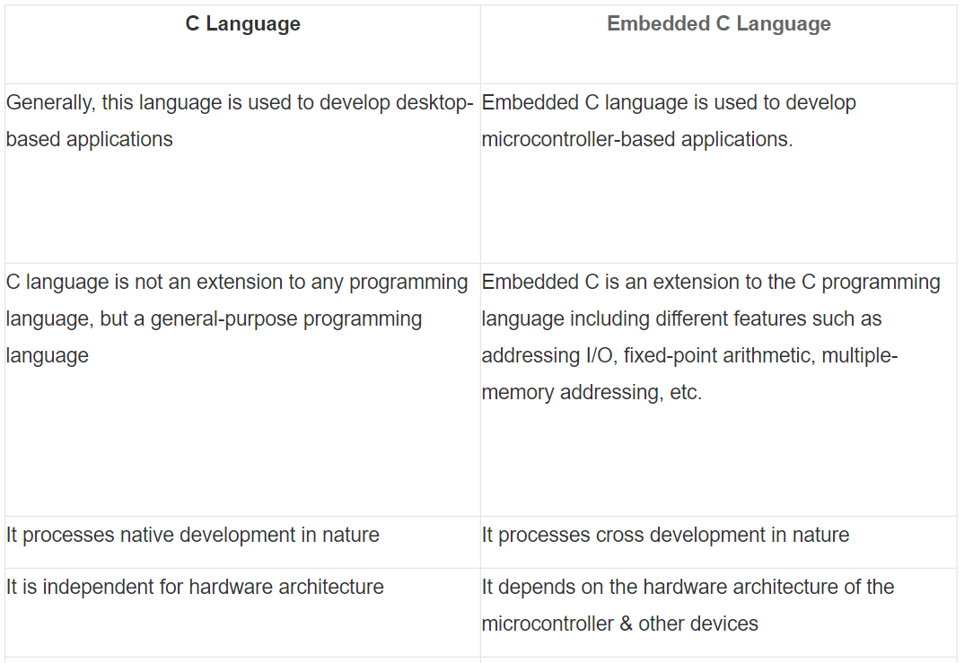
C vs Embedded C

Slide 69
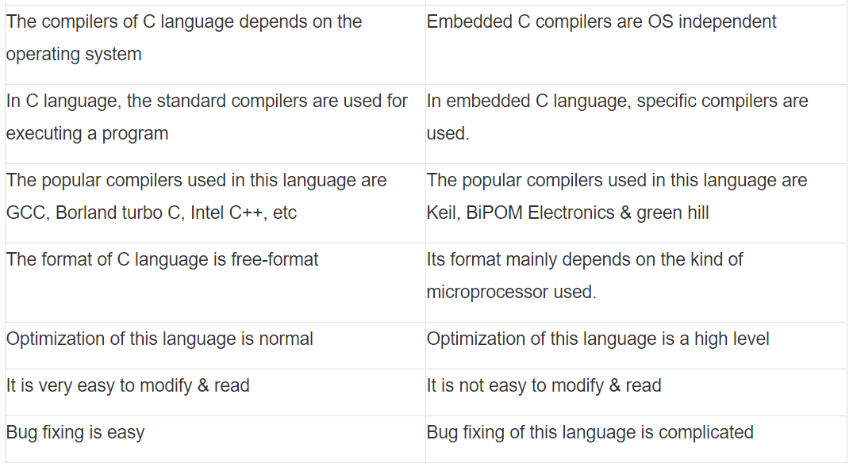
C vs Embedded C

Slide 70
Basics of Embedded C Program
Two of the basic features of the Embedded C Program:
Keywords
Datatypes.

Slide 71
Keywords in Embedded C
A Keyword is a special word with a special meaning to the compiler (a C Compiler for example, is a software that is used to convert program written in C to Machine Code). For example, if we take the Keil’s Cx51 Compiler (a popular C Compiler for 8051 based Microcontrollers) the following are some of the keywords:
bit-
sbit - The sbit type defines a bit within a special function register (SFR).
sfr- special function registers
small
large

Slide 72
Keywords in Embedded C
The following table lists out all the keywords associated with the Cx51 C Compiler.
_at_ | alien | bdata
bit | code | compact
data | far | idata
interrupt | large | pdata
_priority_ | reentrant | sbit
sfr | sfr16 | small
_task_ | using | xdata

Slide 73
Data Types in Embedded C
Data Types in C Programming Language (or any programming language for that matter) help us declaring variables in the program. There are many data types in C Programming Language like signed int, unsigned int, signed char, unsigned char, float, double, etc. In addition to these there few more data types in Embedded C.
The following are the extra data types in Embedded C associated with the Keil’s Cx51 Compiler.
bit
sbit
sfr
sfr16

Slide 74
Data Types in Embedded C
sbit
This is one kind of data type, used to access a single bit within an SFR register.
The syntax for this data type is : sbit variable name = SFR bit ;
Example: sbit a=P2^1;
If we assign p2.1 as ‘a’ variable, then we can use ‘a’ instead of p2.1 anywhere in the program, which reduces the complexity of the program.

Slide 75
Data Types in Embedded C
Bit
This type of data type is mainly used for allowing the bit addressable memory of random access memory like 20h to 2fh.
The syntax of this data type is : name of bit variable;
Example: bit c;
It is a bit series setting within a small data region that is mainly used with the help of a program to memorize something.

Slide 76
Data Types in Embedded C
SFR
This kind of data type is used to obtain the peripheral ports of the SFR register through an additional name. So, the declaration of all the SFR registers can be done in capital letters.
The syntax of this data type is: SFR variable name = SFR address for SFR register;
Example: SFR port0 = 0×80;
If we allocate 0×80 like ‘port0’, after that we can utilize 0×80 in place of port0 wherever in the programming language to decrease the difficulty of the program.

Slide 77
Data Types in Embedded C
SFR Register
The SFR stands for Special Function Register. In 8051 microcontroller, it includes the RAM memory with 256 bytes, which is divided into two main elements: the first element of 128 bytes is mainly utilized for storing the data whereas the other element of 128 bytes is mainly utilized to SFR registers. All the peripheral devices such as timers, counters & I/O ports are stored within the SFR register & every element includes a single address.

Slide 78
Data Types in Embedded C
The following table shows some of the data types in Cx51 Compiler along with their ranges.
Data Type | Bits (Bytes) | Range
bit | 1 | 0 or 1 (bit addressable part of RAM)
signed int | 16 (2) | -32768 to +32767
unsigned int | 16 (2) | 0 to 65535
signed char | 8 (1) | -128 to +127
unsigned | 8 (1) | 0 to 255
float | 32 (4) | ±1.175494E-38 to ±3.402823E+38
double | 32 (4) | ±1.175494E-38 to ±3.402823E+38
sbit | 1 | 0 or 1 (bit addressable part of RAM)
sfr | 8 (1) | RAM Addresses (80h to FFh)
sfr16 | 16 (2) | 0 to 65535

Slide 79
Different Components of an Embedded C Program
Steps to Build an Embedded C Program
There are different steps involved in designing an embedded c program like the following.
Comments
Directives of Processor
Configuration of Port
Global variables
Core Function/Main Function
Declaration of Variable
The logic of the Program

Slide 80
Different Components of an Embedded C Program
Comments: Comments are readable text that are written to help us (the reader) understand the code easily. They are ignored by the compiler and do not take up any memory in the final code (after compilation).
There are two ways you can write comments: one is the single line comments denoted by // and the other is multiline comments denoted by /*….*/.
In an embedded C programming language, we can place comments in our code which helps the reader to understand the code easily.
C=a+b; /* add two variables whose value is stored in another variable C*/

Slide 81
Different Components of an Embedded C Program
Single Line Comment
Generally, for the programming languages, single-line comments are very useful to clarify a fraction of the program. These comments begin with a double slash (//) and it can be located anywhere within the programming language. By using this, the whole line can be ignored within a program.
Multi-Line Comment
Multi-line comments begin with a single slash (/) & an asterisk (/*) in the programming languages which explains a block of code. These types of comments can be arranged anywhere within the programming language and mainly used to ignore a whole block of code within a program.

Slide 82
Different Components of an Embedded C Program
Preprocessor Directive:
The lines included within the program code are called preprocessor directives which can be followed through a hash symbol (#). These lines are the preprocessor directives but not programmed statements.
the #include directive is generally used to comprise standard libraries like study and. h is used to allow I/O functions using the library of ‘C’.
The #define directive usually used to describe the series of variables & allocates the values by executing the process within a particular instruction like macros.

Slide 83
Different Components of an Embedded C Program
A Preprocessor Directive in Embedded C is an indication to the compiler that it must look in to this file for symbols that are not defined in the program.
In C Programming Language (also in Embedded C), Preprocessor Directives are usually represented using # symbol like #include… or #define….
In Embedded C Programming, we usually use the preprocessor directive to indicate a header file specific to the microcontroller, which contains all the SFRs and the bits in those SFRs.
In case of 8051, Keil Compiler has the file “reg51.h”, which must be written at the beginning of every Embedded C Program.

Slide 84
Different Components of an Embedded C Program
Configuration of Port
The microcontroller includes several ports where every port has different pins. These pins can be used for controlling the interfacing devices. The declaration of these pins can be done within a program with the help of keywords. The keywords in the embedded c program are standard as well as predefined like a bit, sbit, SFR which are used to state the bits & single pin within a program.
There are certain words that are reserved for doing specific tasks. These words are known as keywords. They are standard and predefined in the Embedded C. Keywords are always written in lowercase. These keywords must be defined before writing the main program. The main functions of the keywords include the following.

Slide 85
Different Components of an Embedded C Program
Global Variables: Global Variables, as the name suggests, are Global to the program i.e., they can be accessed anywhere in the program.
When the variable is declared before the key function is known as the global variable. This variable can be allowed on any function within the program. The global variable’s life span mainly depends on the programming until it reaches an end.
#include<reg51.h> Unsigned int a, c =10; Main() { …………… ………….. }

Slide 86
Different Components of an Embedded C Program
Local Variables: Local Variables, in contrast to Global Variables, are confined to their respective function.
Core Function / Main Function
Every C or Embedded C Program has one main function, from where the execution of the program begins . The main function is a central part while executing any program and it begins with the main function simply. Each program utilizes simply one major function since if the program includes above one major function, next the compiler will be confused in begin the execution of the program.
#include<reg51.h> Main() { …………… ………….. }

Slide 87
Basic Structure of an Embedded C Program (Template for Embedded C Program)
Main Function . . . . . Main Function, execution begins here { Local Variables . . . . . Variables confined to main function Function Calls . . . . . Calling other Functions Infinite Loop . . . . . Like while(1) or for(;;) Statements . . . . . …. …. }
Function Definitions . . . . . Defining the Functions { Local Variables . . . . . Local Variables confined to this Function Statements . . . . . …. …. }

Slide 88
Basic Structure of an Embedded C Program (Template for Embedded C Program)
Declaration of Variable
The name like the variable is used for storing the values but this variable should be first declared before utilized within the program. The variable declaration states its name as well as a data type. Here, the data type is nothing but the representation of storage data. In embedded C programming, it uses four fundamental data types like integer, float, character for storing the data within the memory. The data type size, as well as range, can be defined depending on the compiler.
The data type refers to an extensive system for declaring variables of different types like integer, character, float, etc. The embedded C software uses four data types that are used to store data in memory.
The ‘char’ is used to store any single character; ‘int’ is used to store integer value, and ‘float’ is used to store any precision floating-point value. The size and range of different data types on a 32-bit machine are given in the following table. The size and range may vary on machines with different word sizes.
The char/signed char data type size is 1 byte and its range is from -128 to +128
The unsigned char data type size is 1 byte and its range is from 0 to 255
Int/signed int data type size is 2 byte and its range is from -32768 to 32767
Unsigned int data type size is 2 byte and its range is from 0 to 65535

Slide 89
Basic Structure of an Embedded C Program (Template for Embedded C Program)
The logic of the Program
The logic of the program is a plan of the lane that appears in the theory behind & predictable outputs of actions of the program. It explains the statement otherwise theory regarding why the embedded program will work and shows the recognized effects of actions otherwise resources.
Main { LED = 0x0f; delay(100); LED = 0x00; delay(100); }

Slide 90
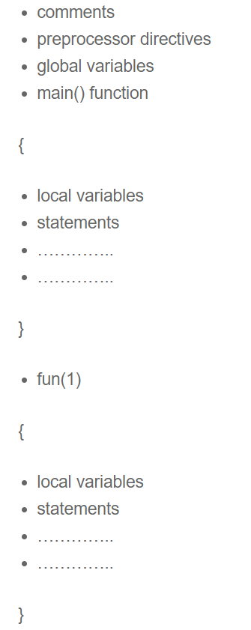
Structure of the Embedded C program

Slide 91
Example of Embedded C Program
In this example, we will use an 8051 Microcontroller to blink LEDs connected to PORT1 of the microcontroller.
The circuit contains an 8051 based Microcontroller (AT89S52) along with its basic components (like RESET Circuit, Oscillator Circuit, etc.) and components for blinking LEDs (LEDs and Resistors).
In order to write the Embedded C Program for the above circuit, we will use the Keil C Compiler. This compiler is a part of the Keil µVision IDE.

Slide 92
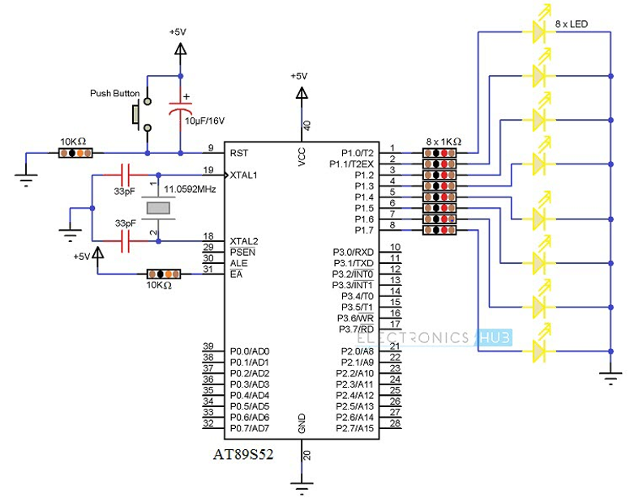
Circuit diagram for the example circuit.

Slide 93
Program
#include<reg51.h> // Preprocessor Directive void delay (int); // Delay Function Declaration
void main(void) // Main Function { P1 = 0x00; /* Making PORT1 pins LOW. All the LEDs are OFF. * (P1 is PORT1, as defined in reg51.h) */
while(1) // infinite loop { P1 = 0xFF; // Making PORT1 Pins HIGH i.e. LEDs are ON. delay(1000); /* Calling Delay function with Function parameter as 1000. * This will cause a delay of 1000mS i.e. 1 second */
P1 = 0x00; // Making PORT1 Pins LOW i.e. LEDs are OFF. delay(1000); } }

Slide 94
Program
void delay (int d) // Delay Function Definition { unsigned int i=0; // Local Variable. Accessible only in this function. /* This following step is responsible for causing delay of 1000mS * (or as per the value entered while calling the delay function) */
for(; d>0; d–) { for(i=250; i>0; i – -); for(i=248; i>0; i – -); } }

Slide 95
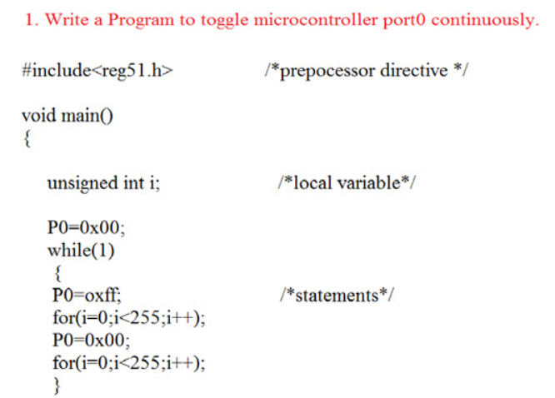
Program1

Slide 96
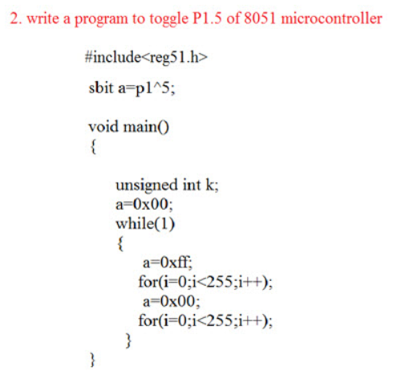
Program2

Slide 97
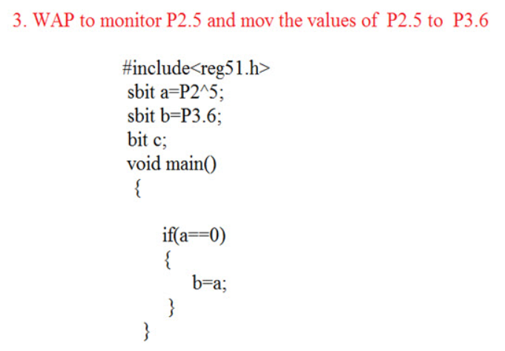
Program 3

Slide 98
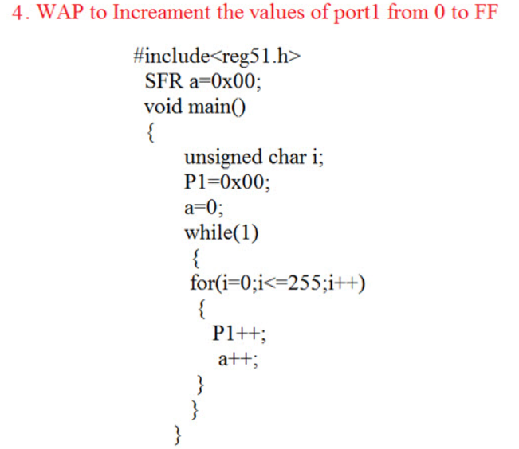
Program 4

Slide 99
Advantages of Embedded C
It is very simple to understand.
It executes a similar task continually so there is no requirement for changing hardware like additional memory otherwise storage space.
It executes simply a single task at once
The cost of the hardware used in the embedded c is typically so much low.
The applications of embedded are extremely appropriate in industries.
It takes less time to develop an application program.
It reduces the complexity of the program.
It is easy to verify and understand.
It is portable from one controller to another.

Slide 100
Disadvantages of Embedded C
At a time, it executes only one task but can’t execute the multi-tasks
If we change the program then need to change the hardware as well
It supports only the hardware system.
It has a scalability issue
It has a restriction like limited memory otherwise compatibility of the computer.

Slide 101
Applications of Embedded C Program
Embedded C programming is used in industries for different purposes
The programming language used in the applications is speed checker on the highway, controlling of traffic lights, controlling of street lights, tracking the vehicle, artificial intelligence, home automation, and auto intensity control.

